Slide 1
CeNSE Evacuation Procedure
CeNSE-EP-01 Version 4.5
2025
Reviewer | Approver
CeNSE EHSS Committee | Chair, CeNSE EHSS Committee
Date | 07-01-2026

Slide 2
ERT Members
 | Primary | Backup | Responsibility (in order)
ERT 1 | Pavan Nukala | Sushobhan Avasthi | Primary incharge of all safety incident. Part of 3-man team that investigates the incident. If needed, call fire. When appropriate, declare "all-clear“
 | P: 9515393595 | P: 9902333360
 | pnukala@iisc.ac.in | savasthi@iisc.ac.in
ERT-2 | Gajendra M | Jagadeesha KB
 | P: 9535550474 | P: 7795385941
 | gajendram@iisc.ac.in; | Jagadeeshakb@iisc.ac.in
ERT-3 | Saurabh Chandorkar | Thiyaganand R
 | P: 7022321404 | P: 8971118917
 | saurabhc@iisc.ac.in | thiyaganandr@iisc.ac.in
ERT-4 | Saleem Ahmed | Arjun M | Incharge of control room. Change the Magnetic board on the Exit door towards Utility building. Call ambulance/security. Collects reports from floor in-charges. Call fire, if needed
 | P: 7348922321 | P: 9496920250
 | saleemb@iisc.ac.in | arjunm1.cense@vendor.iisc.ac.in
Assembly point | Suresha S J | Sabiha Sultana | Manage the crowd at assembly point Relay information to control room Do not let people leave Take attendance
 | P:9482773717 | P: 9591323919
 | sureshasj@iisc.ac.in | sabihas@iisc.ac.in

Slide 3
ERT Members
 | Primary | Backup | Responsibility (in order)
Ground Floor Leader | Nandeesh N | Sreetosh Goswami | During evacuation ensure the population to the nearest exit Report to control room if you see any unconscious people Report back to control room after evacuation Do not enter rooms that seem unsafe Do not help unconscious people
 | P: 9980201320 | P: 7044184754
 | nandeeshn.cense@vendor.iisc.ac.in | sreetosh@iisc.ac.in
 | Rajesh R | Bindu Poornima
 | P: 7259631005 | P: 9008465465
 | rajeshr@iisc.ac.in | binduj.cense@vendor.iisc.ac.in
First Floor Leaders | Akshay Naik | Usha Vijay
 | P: 9611396194 | P: 9902599116
 | anaik@iisc.ac.in | ushavijay.cense@vendor.iisc.ac.in
 | Gayathri Pillai | Vini Gautam
 | P: 7642802806 | P: 9108687294
 | gpillai@iisc.ac.in | vini@iisc.ac.in
Second Floor Leader | Manoj Varma | Jithin MA
 | P: 9902346297 | P: 7012177455
 | mvarma@iisc.ac.in | jithinma@iisc.ac.in
 | Somashekar P S | Seema Jaiswal
 | P: 8762203074 | P: 7250211023
 | somashekarps.cense@vendor.iisc.ac.in | seemajaiswal@iisc.ac.in
Third Floor Leaders | Aditya Sadhanala | Anish Itagi
 | P: 9606122796 | P: 7892598535
 | sadhanala@iisc.ac.in | anishitagi.cense@vendor.iisc.ac.in
 | Supradeepa V. R. | Veera Pandi N
 | P: 8277155752 | P: 9739744049
 | supradeepa@iisc.ac.in | veerapandi.cense@vendor.iisc.ac.in

Slide 4
ERT Members
 | Primary | Backup | Responsibility (in order)
MNCF Leaders | Abhishek Chaturvedi | Dhanalakshmi | 1. Make sure MNCF evacuates 2. Report to control room
 | P: 9481940054 | P: 7348860925
 | abhishekc@iisc.ac.in | pdhanalakshm.cense@vendor.iisc.ac.in
 | Ambresh m | Kumar MP
 | P: 9731883339 | P: 9886565894
 | ambreshm@iisc.ac.in | kumarmp.cense@vendor.iisc.ac.in
NNFC Leaders | Ajeya Shettar | JAYACHANDRA REDDY | 1. Make sure NNFC evacuates 2. Report to control room
 | P: 8861817002 | P: 8792207303
 | ajeyashettar@iisc.ac.in | jayachandrar@iisc.ac.in
 | Chandan HB | Rekha
 | P: 9036423944 | P:7760107913
 | chandanh@iisc.ac.in | rekham@iisc.ac.in

Slide 5


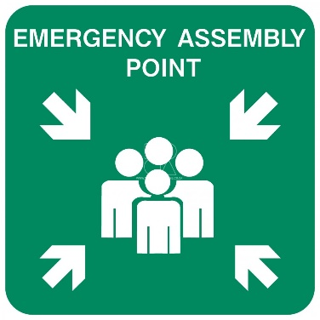
Evacuation procedure: During Working Hours
(BMS)
Report to ERT in control room
(BMS)
Note alarm location. Take over BMS computer
(BMS)
Generate list of occupants from biometric
All information goes through control room
(ERT4)
Change the Magnetic board on the Exit door towards Utility building.
(ERT4)
Set-up control room in GF09. Get brief from BMS
(ERT4)
Call security. If ERT asks, call fire truck &ambulance
(ERT4)
Coordinate with ambulance/fire
(ERT1, 2 & 3)
Go to control room. Get brief from BMS.
(ERT1, 2 & 3)
Investigate. Carry walkie. Use SCUBA for plenum, SF30, 31, 32, and 33.
(ERT1, 2 & 3)
Cordon off the area. Victims? Turn-off power? Open windows?
(ERT1, 2 & 3)
Go to control room
Alarm
(AP Incharge)
Go to the assembly point. Manage the crowd.
(AP Incharge)
Any pertinent information from crowd?
(AP Incharge) Count the NNfC & MNCF occupants.
(AP Incharge) One reverts to control room
(AP Incharge) Go back & take attendance for NNfC & MNCF occupants
(Floor Leaders)
Evacuate your floor. Do not enter plenum, SF30, 31, 32, and 33. Just knock.
(Floor Leaders)
Report to control room.
= Assembly point
= BMS
= ERT 1/2/3
= Control room
= ERT4
= Assembly point incharge
= Accident site
= Floor/NNfC/MNCF Leaders

Slide 6
Evacuation procedure: During Non-Working Hours
(BMS)
Go to control room. Note alarm location.
(BMS)
Go to accident site. Do what you can. Call & brief ERT
(BMS)
If needed, call security, fire truck, ambulance
(BMS)
Arrange a floor-wise search using security & volunteers
(ERT4)
Coordinate with ambulance/fire
Alarm
(ERT1, 2 & 3)
Go to accident site. Get brief from BMS.
(ERT1, 2 & 3)
Investigate. Carry walkie. Use SCUBA for plenum, SF30, 31, 32, and 33.
(ERT1, 2 & 3)
Cordon off the area. Victims? Turn-off power? Open windows?
(ERT1, 2 & 3)
Go to control room
ERT1 is the first faculty or senior staff on the scene.
ERT 2 is one of the BMS staff on-site.
Use help of on-site security. They can coordinate with ambulance and fire station.
= Assembly point
= BMS
= ERT 1/2/3
= Control room
= ERT4
= Assembly point incharge
= Accident site
= Floor/NNfC/MNCF Leaders

Slide 7
Actors and Actions
ERT 1,2,3
ERT 4
BMS
The Job
Respond to the emergency
Do
Take walkie-talkie from BMS
Handle the emergency as appropriate and cordon off the area
Issue all-clear
Do not
Enter hazardous rooms without SCUBA
Take decisions
The Job
Manage control room
Do
Upon evacuation, take over the control room
Interact with floor leader & assembly point incharges.
Call security, fire, ambulance
Do not
Go to incident site.
Assist security, fire, ambulance
Change the Magnetic board on the Exit door towards Utility building.
The Job:
Primary source of information.
Do:
Go to control room
Locate the incident site
Quickly call ERT 1/2/3
Hand over walkie-talkie and provide brief
Find # of occupants from biometric
Do not:
Stay in BMS room.

Slide 8
Actors and Actions
Assembly Point In Charges
Floor/MNCF/NNfC Leaders
The Job:
Manage the crowd at assembly point
Do:
Collect pertinent information from the crowd
Count MNCF/NNfC occupants
Report to Control room with the count and information
Do not:
Let people leave
Collect attendance sheet from emergency room
Take attendance of NNfC & MNCF occupants
The Job:
Ensure population evacuates through the nearest exit
Do:
Knock on lab door to ask people to leave
Report back to control room after evacuation
Do not:
Enter rooms that seem unsafe
Help unconscious people

Slide 9
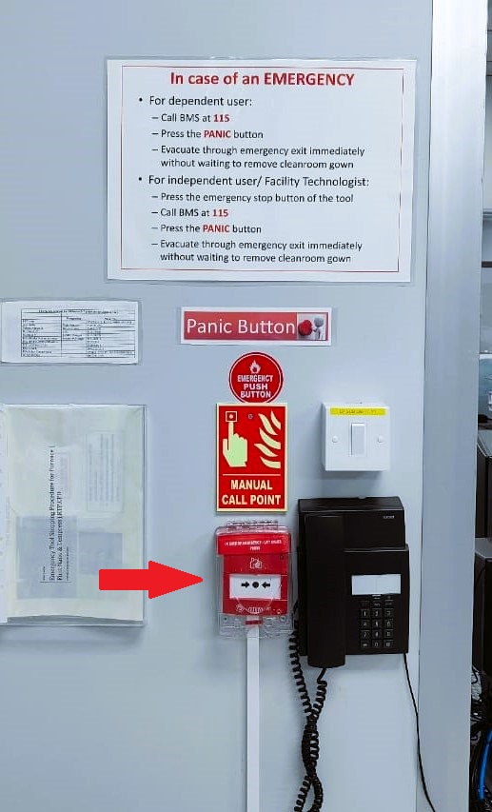
FAQ
Posters in each bay describe the emergency evacuation procedure
Panic button clearly marked
Emergency shut down protocol of tools – one copy in BMS, one at the bay
2 BMS personnel are present at all times
BMS personnel trained on tool emergency shutdown
In case of alarm, DO NOT wait for any confirmation or announcement. Just leave
Panic Button are to be pressed only for Facility Emergency and not for personnel emergency. Call BMS for personnel emergency

Slide 10


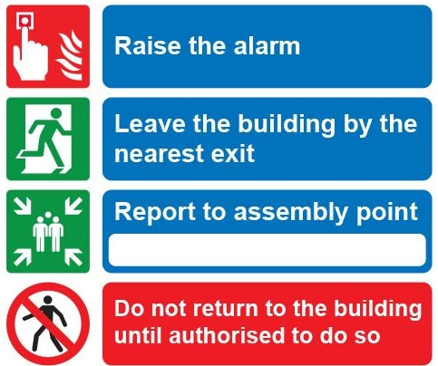
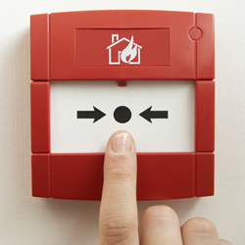
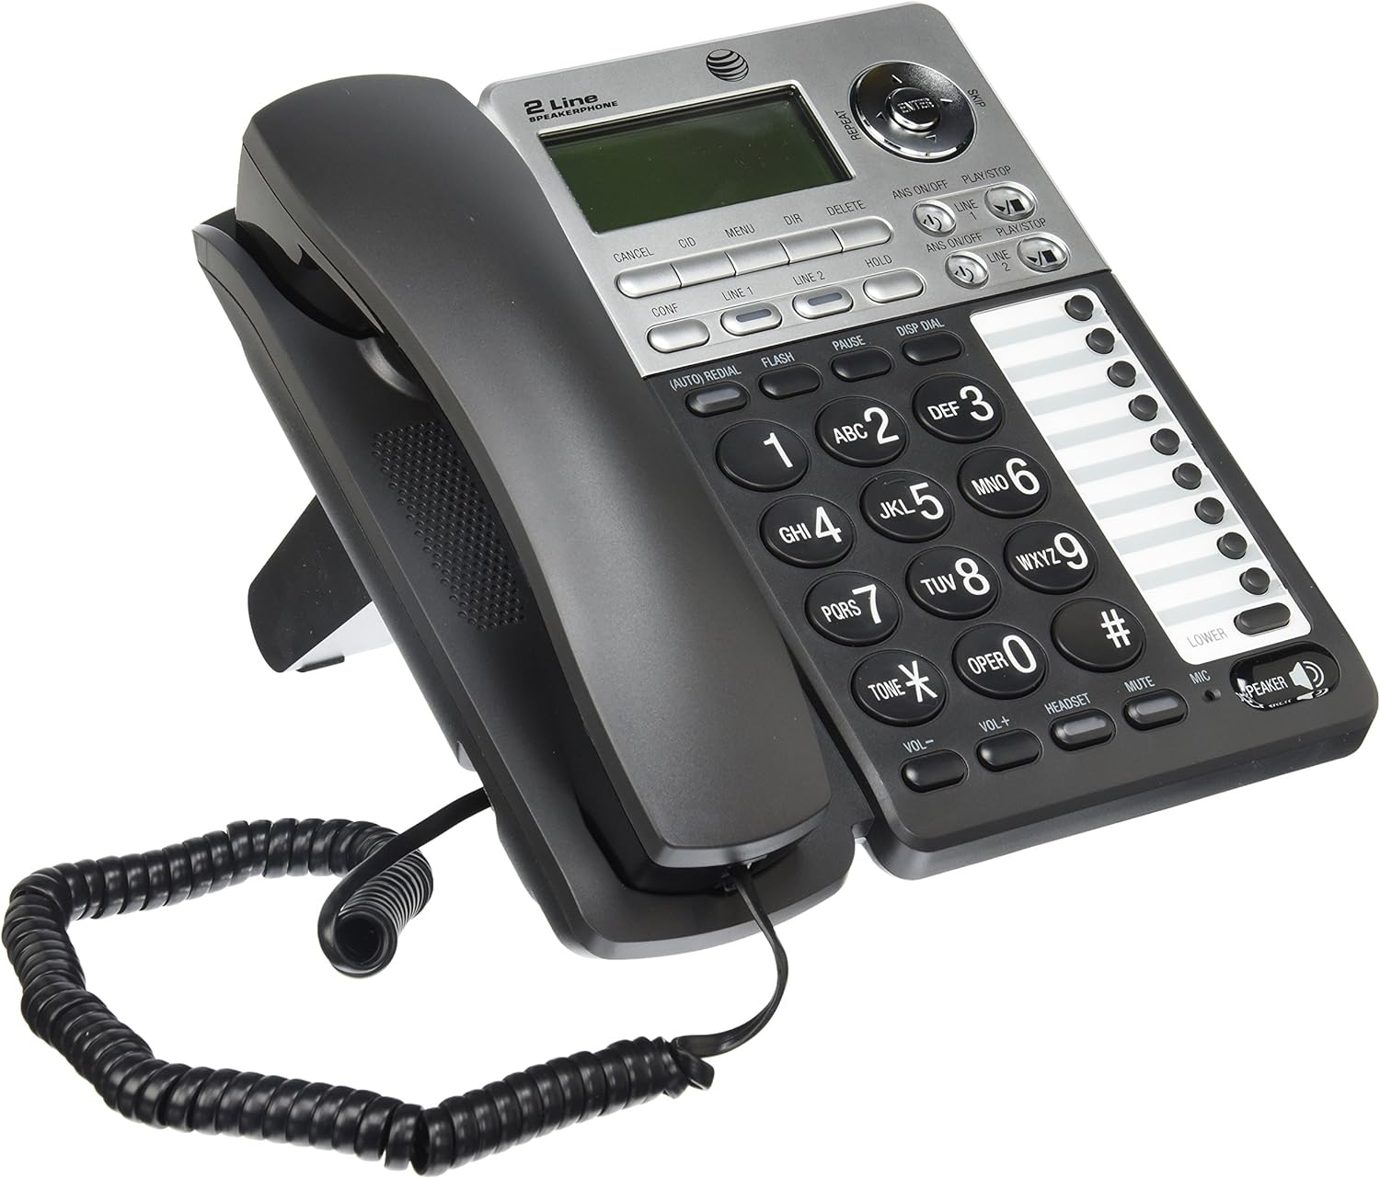
Step 1: Raise the Alarm
Facility Emergency
Local Emergency
Fire/ Smoke
Injury
Spills
Trigger fire alarm. Press panic button
Call at 115
Prioritize your safety. We don’t want two victims.
Err on the side of caution

Slide 11
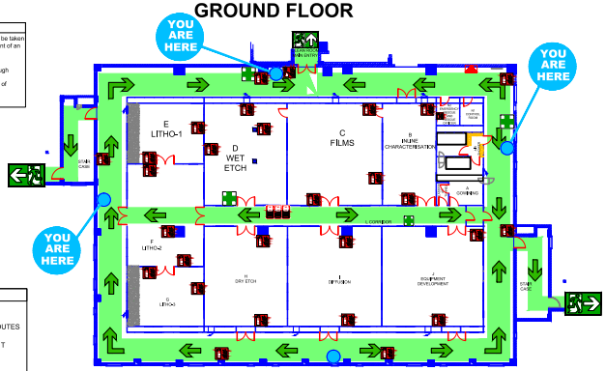
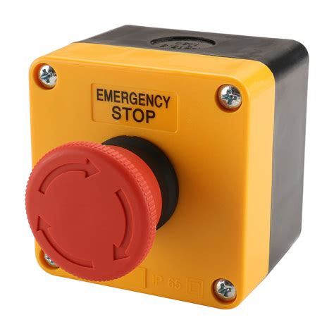
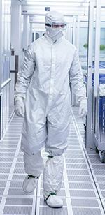


Step 2: Evacuate
Hit emergency stop button
Take the nearest exit
Follow signs towards exit
Don’t use lifts
Don’t remove gown

Slide 12
Step 2A: Additional Instruction for Tool Alarms in LPCVD/Diffusion
Call at 115 from corridor

Slide 13
Step 2C: Power Outage
Cleanroom is on UPS backup, so power should never go out in NNfC
In case of power loss, wait for 2 mins
Tools are designed to default to a “safe” state
Diesel generator should come online
Else, assume a major breakdown and evacuate.

Slide 14
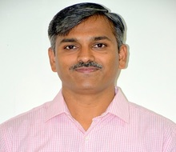
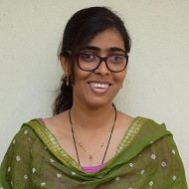
Step 3: Report to Assembly Point
Please obey assembly point in charges
Inform them if you have any pertinent information
Dr. Suresha
Sabiha
Go to the designated assembly point
Stay in the assembly area. We need a headcount of NNfC & MNCF occupants
Don’t go for coffee!

Slide 15
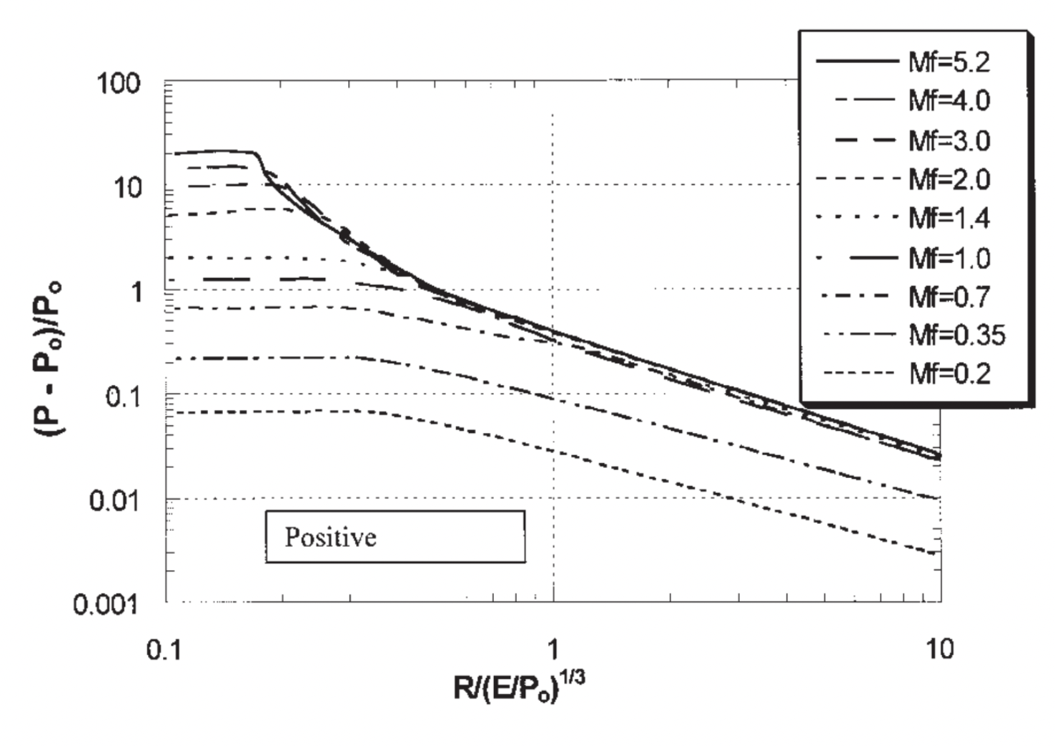
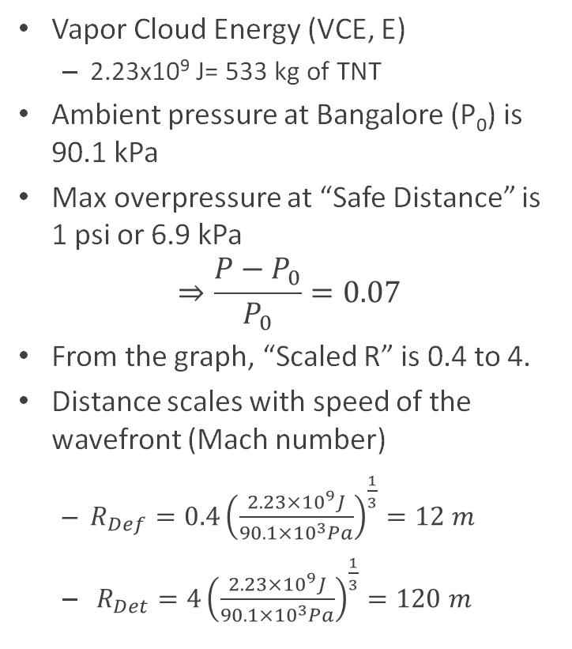
Overpressure Calculations
Mach number
Detonation
Vapor Cloud Energy (VCE, E)
2.23x10⁹ J= 533 kg of TNT
Ambient pressure at Bangalore (P₀) is 90.1 kPa
Max overpressure at “Safe Distance” is 1 psi or 6.9 kPa
$$⇒\frac{P−P_{0}}{P_{0}}=0.07$$
From the graph, “Scaled R” is 0.4 to 4.
Distance scales with speed of the wavefront (Mach number)
$R_{Def}={0.4\left(\frac{2.23×{10}^{9}J}{90.1×{10}^{3}Pa}\right)}^{\frac{1}{3}}=12 m$
$R_{Det}={4\left(\frac{2.23×{10}^{9}J}{90.1×{10}^{3}Pa}\right)}^{\frac{1}{3}}=120 m$
Deflagration
R_{Def} = 12 m
R_{Det} = 120 m
Pierorazio, A.J., Thomas, J.K., Baker, Q.A. and Ketchum, D.E. (2005), An update to the Baker–Strehlow–Tang vapor cloud explosion prediction methodology flame speed table. Proc. Safety Prog., 24: 59-65. https://doi.org/10.1002/prs.10048

Slide 16
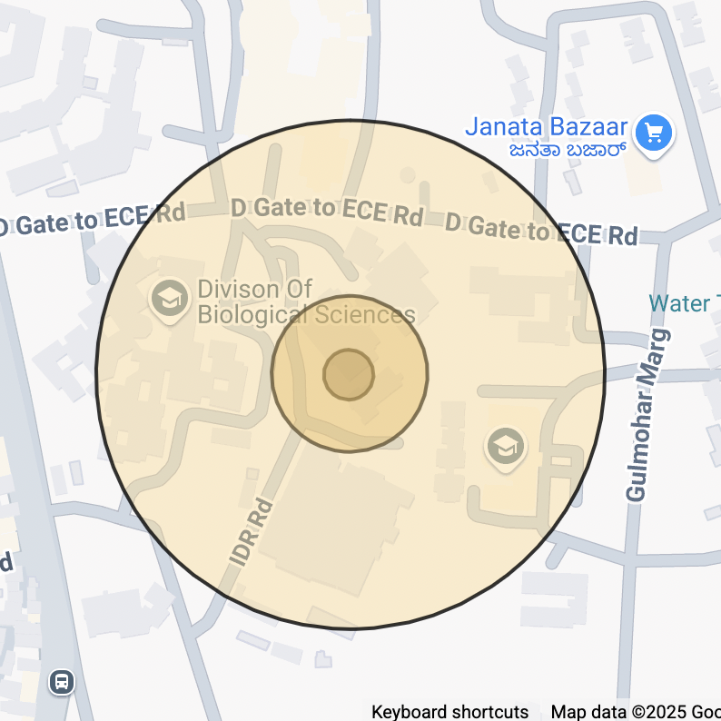
Stand in designated assembly area on the road
Assembly area
Complete destruction
16 m
Limited structural damage
50 m
Minimal Effect
160 m
Gas banks

Slide 17
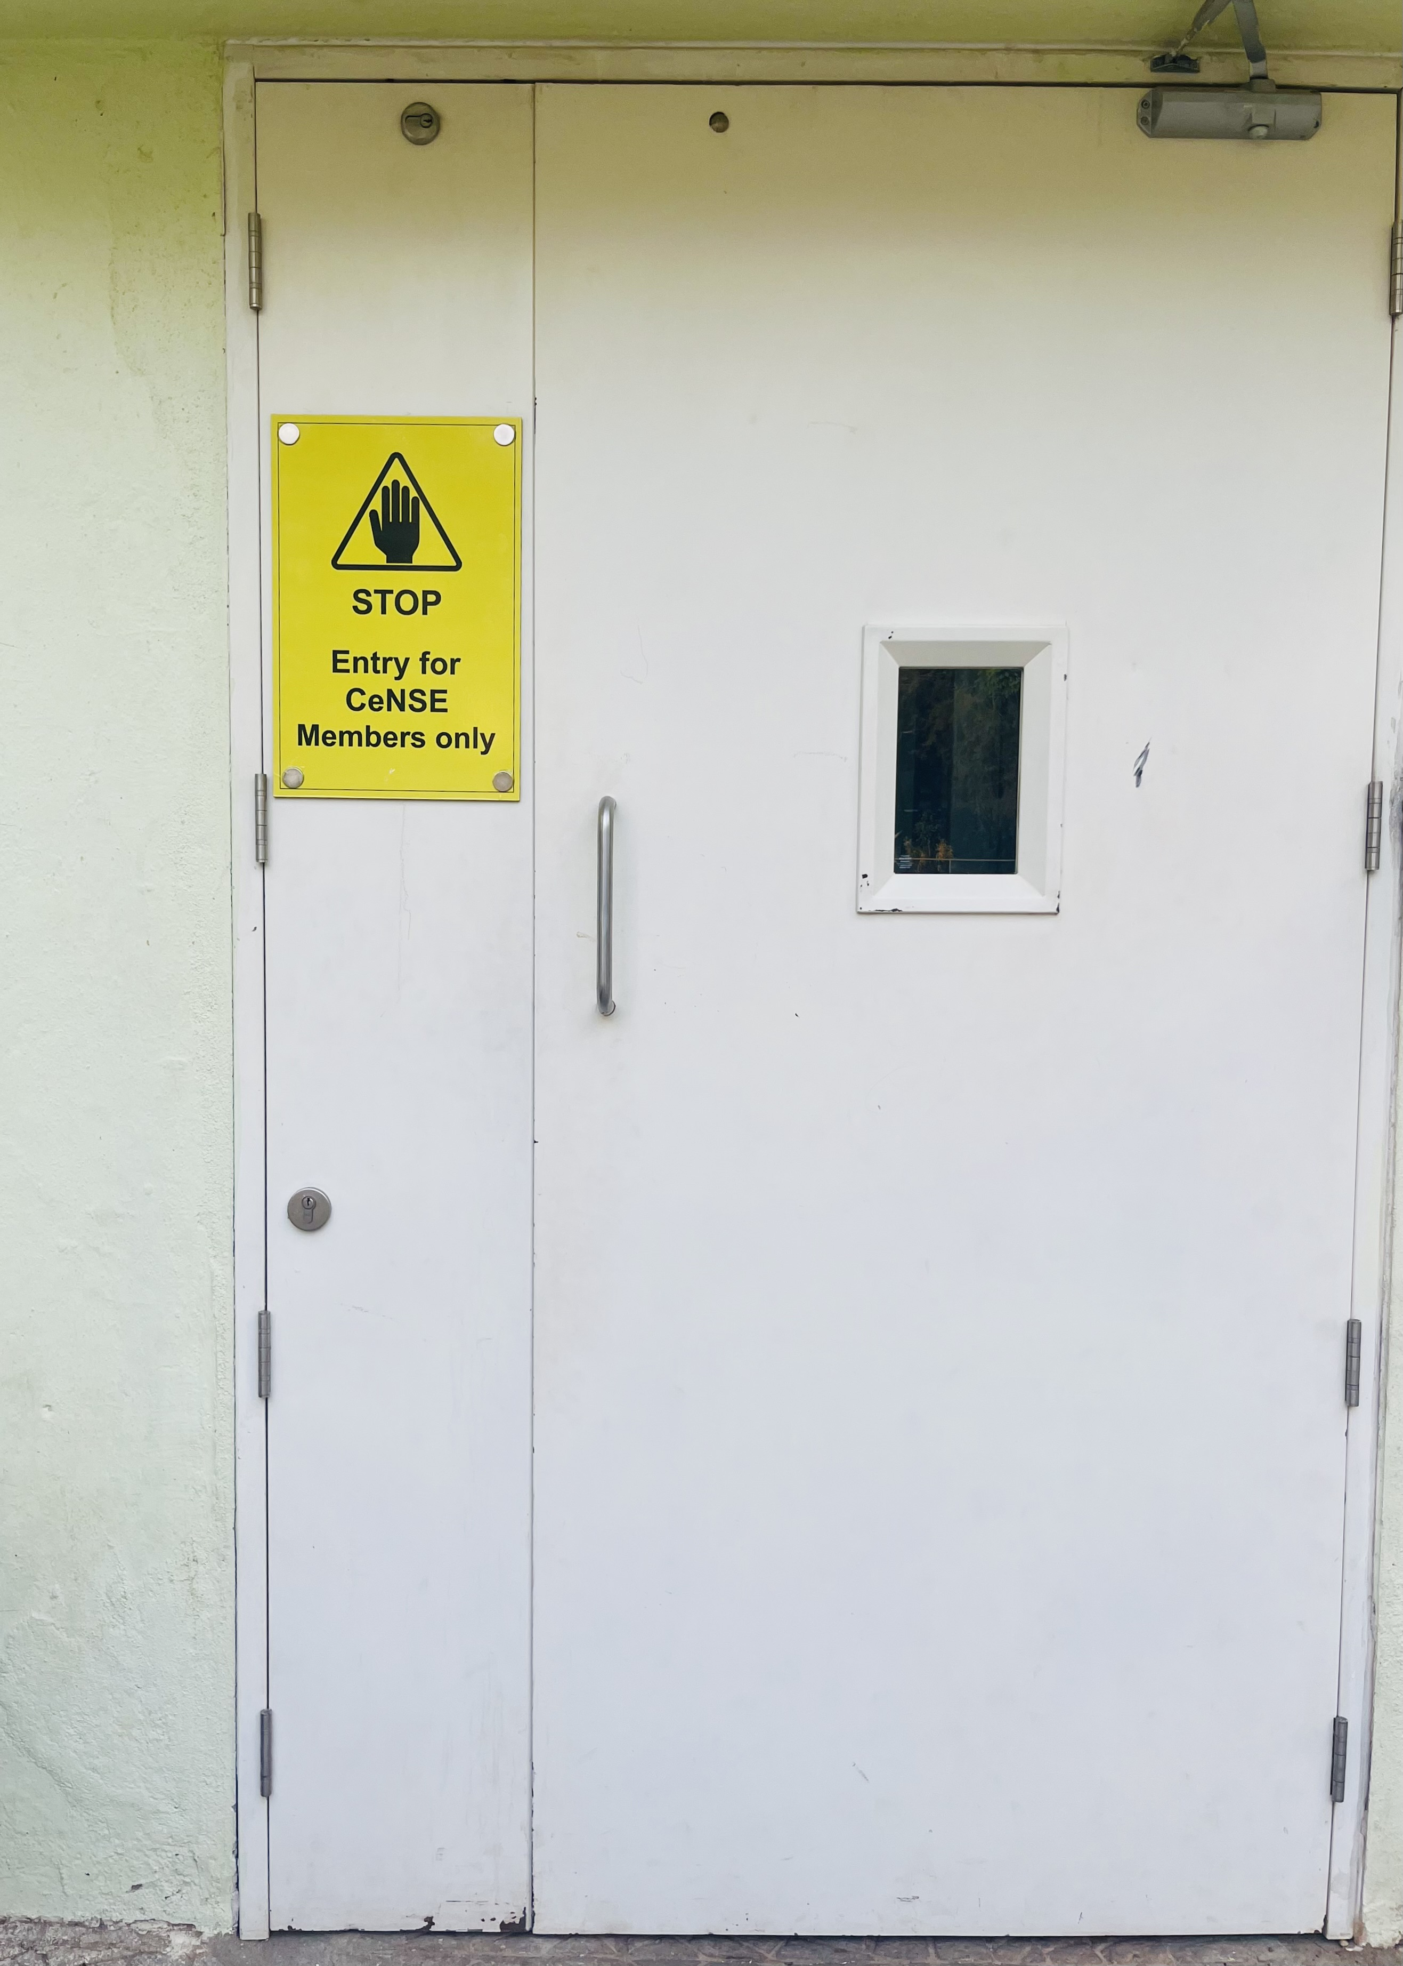
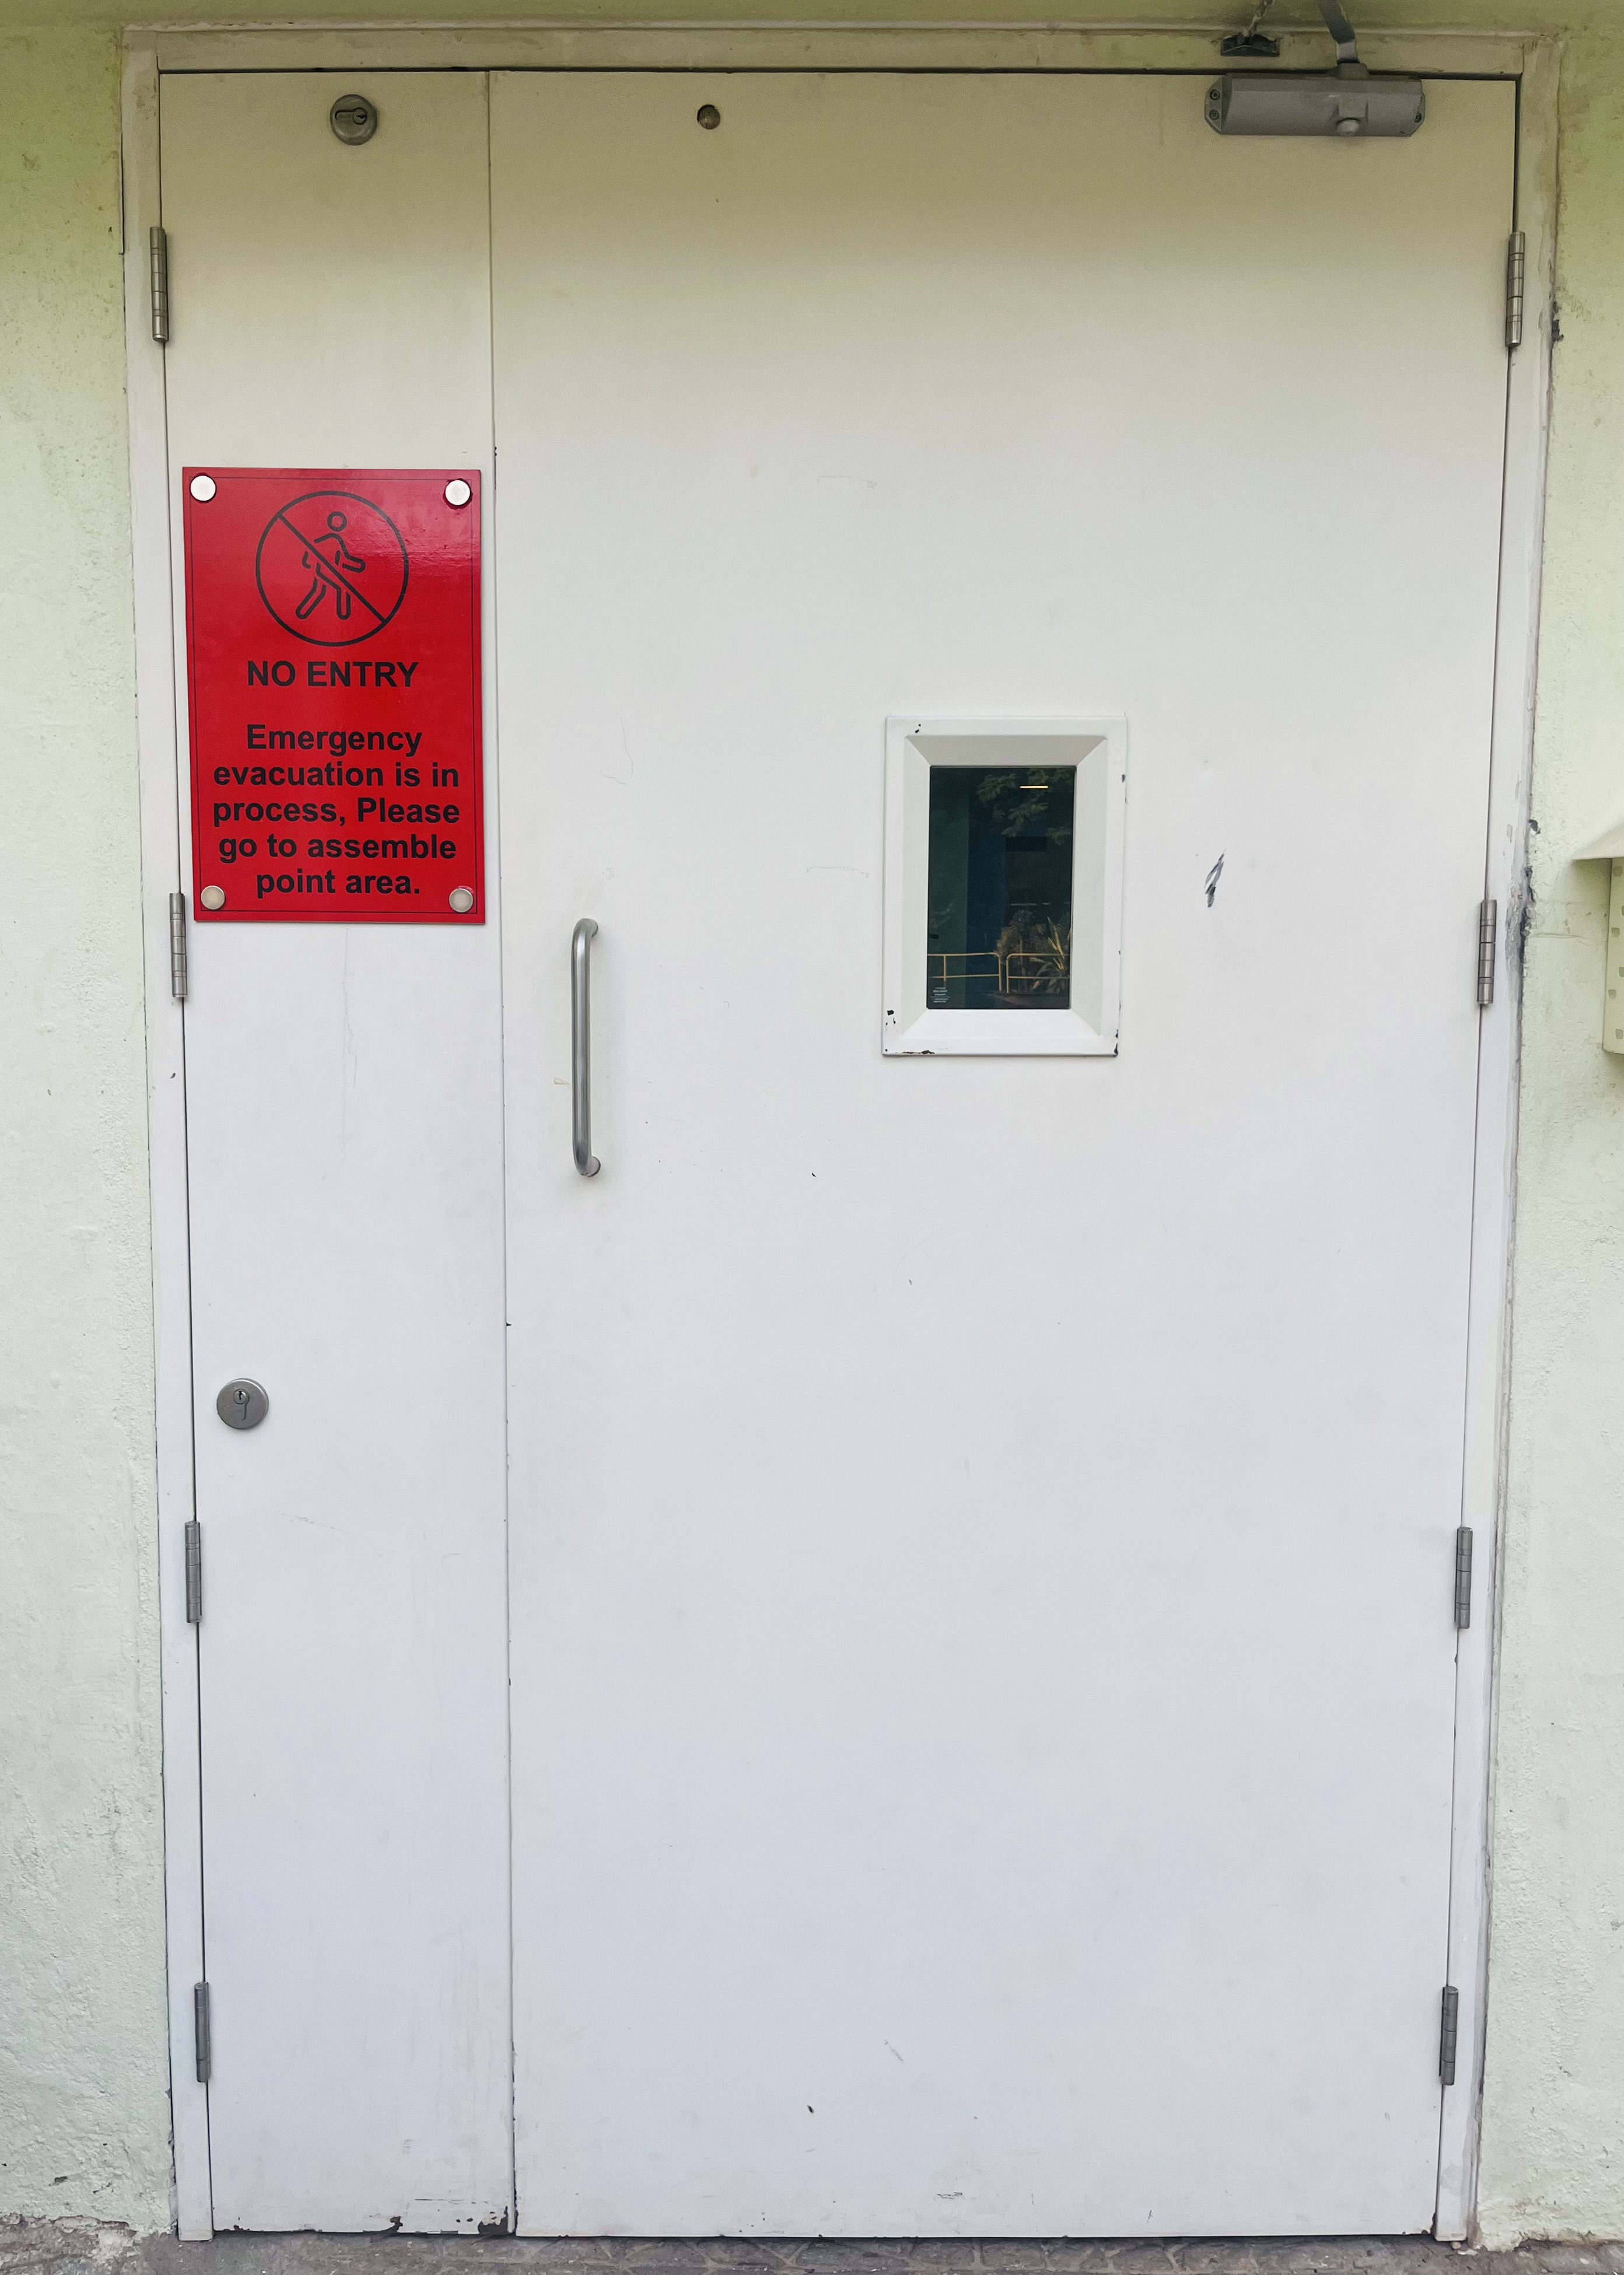

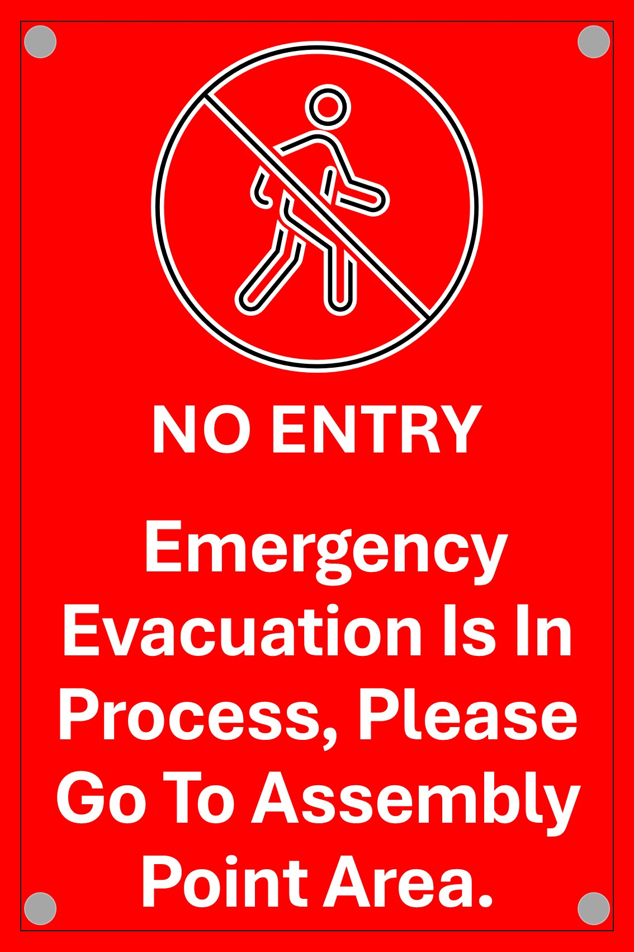
People coming from IDS building
From IDR
Normal day
During Evacuation

Slide 18




Step 3B: Reporting during Non-Office Hours
Go to designated assembly point
Stay in assembly area. We may need a headcount
Don’t go for coffee!
Inform BMS + security
Inform Tool FT/SFT/TM
Message on the User group

Slide 19
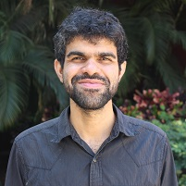
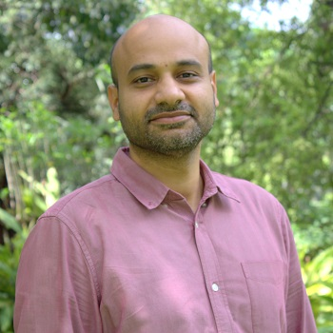


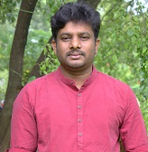
Step 4: Wait for an “All-Clear”
Prof. Pavan
Prof. Sushobhan
Prof Saurabh
Gajendra M
Only the emergency response team (ERT 1, 2, or 3) can give an “all-clear”

Slide 20
Emergency Response: Summary
Call BMS immediately in case of any local emergency
Remember 115.
If 115 is not responsive, call tool owner, bay-in charge, Technology manager, COO -- in that order. Phone numbers are posted near the phone.
In facility emergency, evacuate through nearest exit,
Press panic button if you notice fire or smoke
Don’t wait to ungown
Wait at the assembly points
In non-office hours
Also inform BMS
Call tool owner, bay-in charge, Technology manager, COO -- in that order.
Message the user group

Slide 21
Emergency Numbers
 | Contact | Number
IISc CeNSE | ERT Team | EPABX: 115 P: 080-23229333-24
 | Engineering | EPABX: 128/113 P: 8971118917, 9535550474, 9901011042, 7795385941
 | IISc safety control room | 080-2293 5555
 | IISc Security | 080-2293 2225
 | IISc ICU on Wheels | 080-2293 4444
 | OLSEH Office | 080-2293 3199
 | IISc Health center/Ambulance | 080-2293 2390
 | Snake Rescue Volunteer | 080 2293 2506
Outside | Yeshwanthpur fire station | 080-101, 080-2297 1544
 | Sadashivanagara police station | 080-100, 080-2294 2526
 | Ambulance | 080-102 080-108
 | Mallya Hospital | 080-2224 2325
 | M. S. Ramaiah Hospital | 080-2360 8888
 | Manipal Hospital | 080-2521 1200
 | Columbia Asia | 080-3989 8969
 | Narayana Hrudayalaya | 080-27835000-18

Slide 22
Description Of Revision
Version | Date | Description of Change | Sections Affected | Approved By
4.4 | 2025 | Previous approved version | — | —
4.5 | 07-01-2026 | 1.Updated Emergency Response Team (ERT) members 2. “All-Clear” authority list: Thiyaganand R replaced by Prof. Saurabh | Step 4: Wait for an “All-Clear” (ERT Authorization Section) | Chair, EHSS Committee

